Slide 1
Classifying Wake Stage in Sleep Cycle using Logistic Regression
Marvin Cangcianno
Georgia Institute of Technology

Slide 2
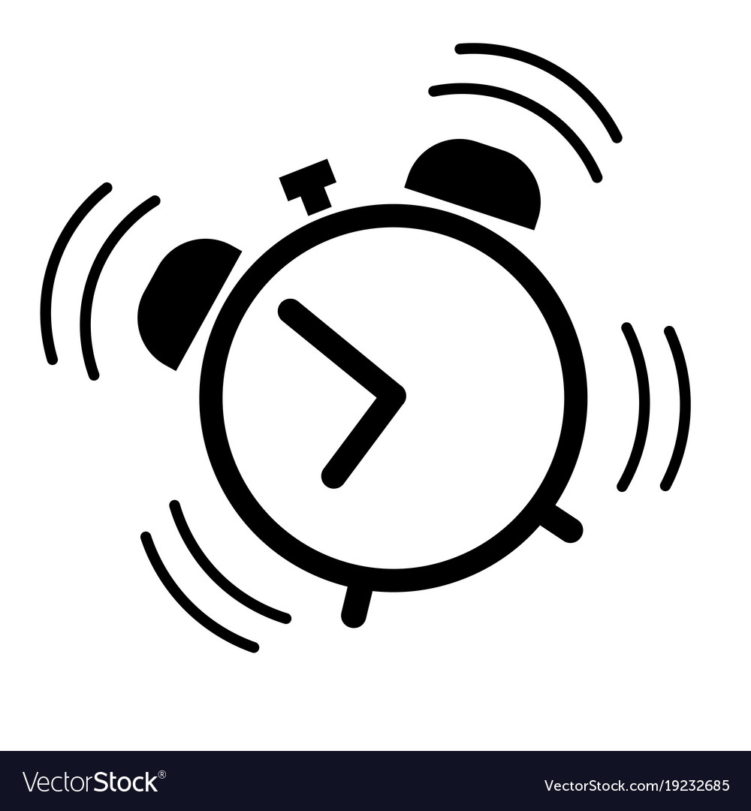

Problem
Notes:
How many times our morning alarm woke us up but we still feel exhausted?

Slide 3
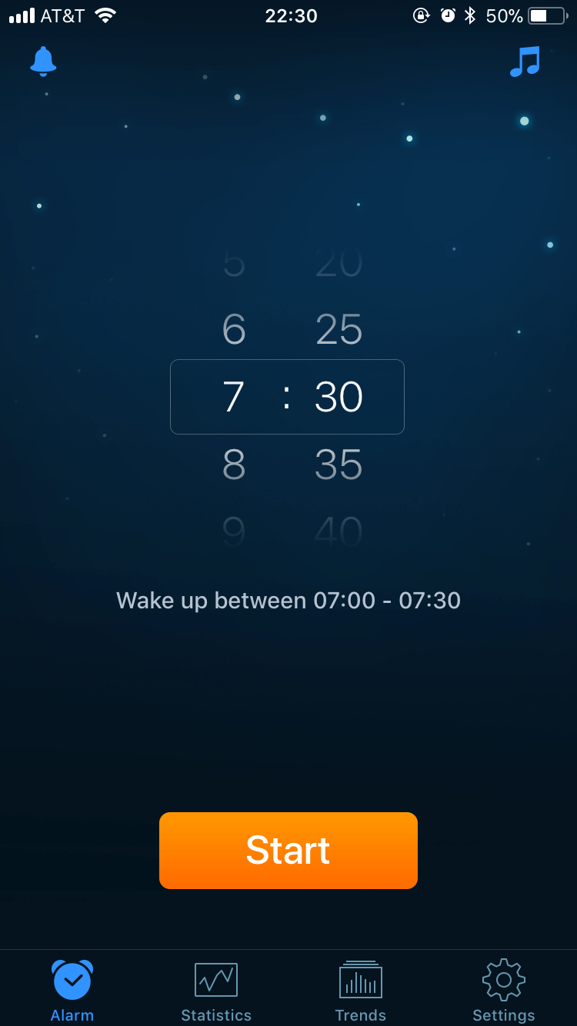
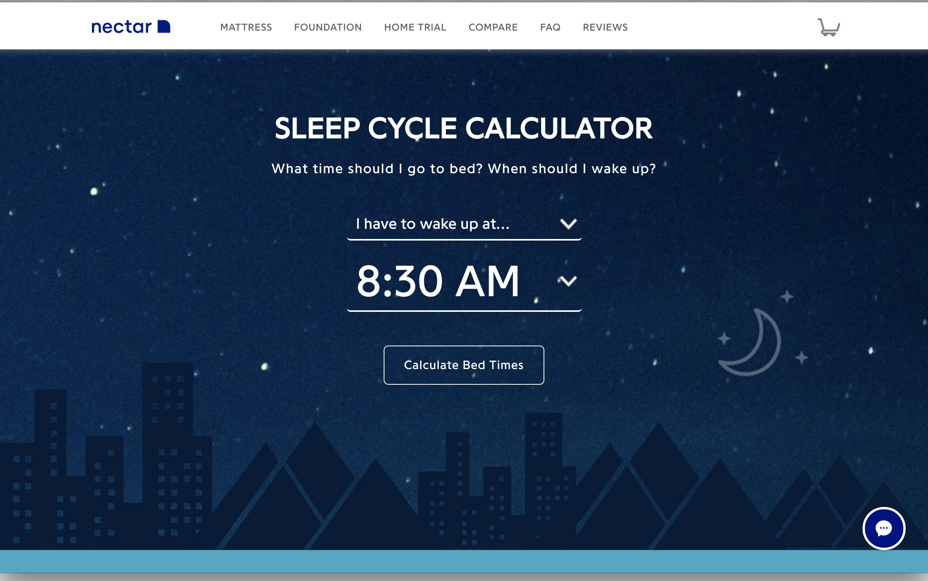
Current Solution
Nectar Sleep Calculator
(https://www.nectarsleep.com/calculator)
Sleep Cycle
(iOS & Android)
Notes:
On the left is nectarsleep.com/calculator
Right is iOS app called Sleep Cycle Calculator, $29.99/yr w/ free one month trial
Problem?

Slide 4
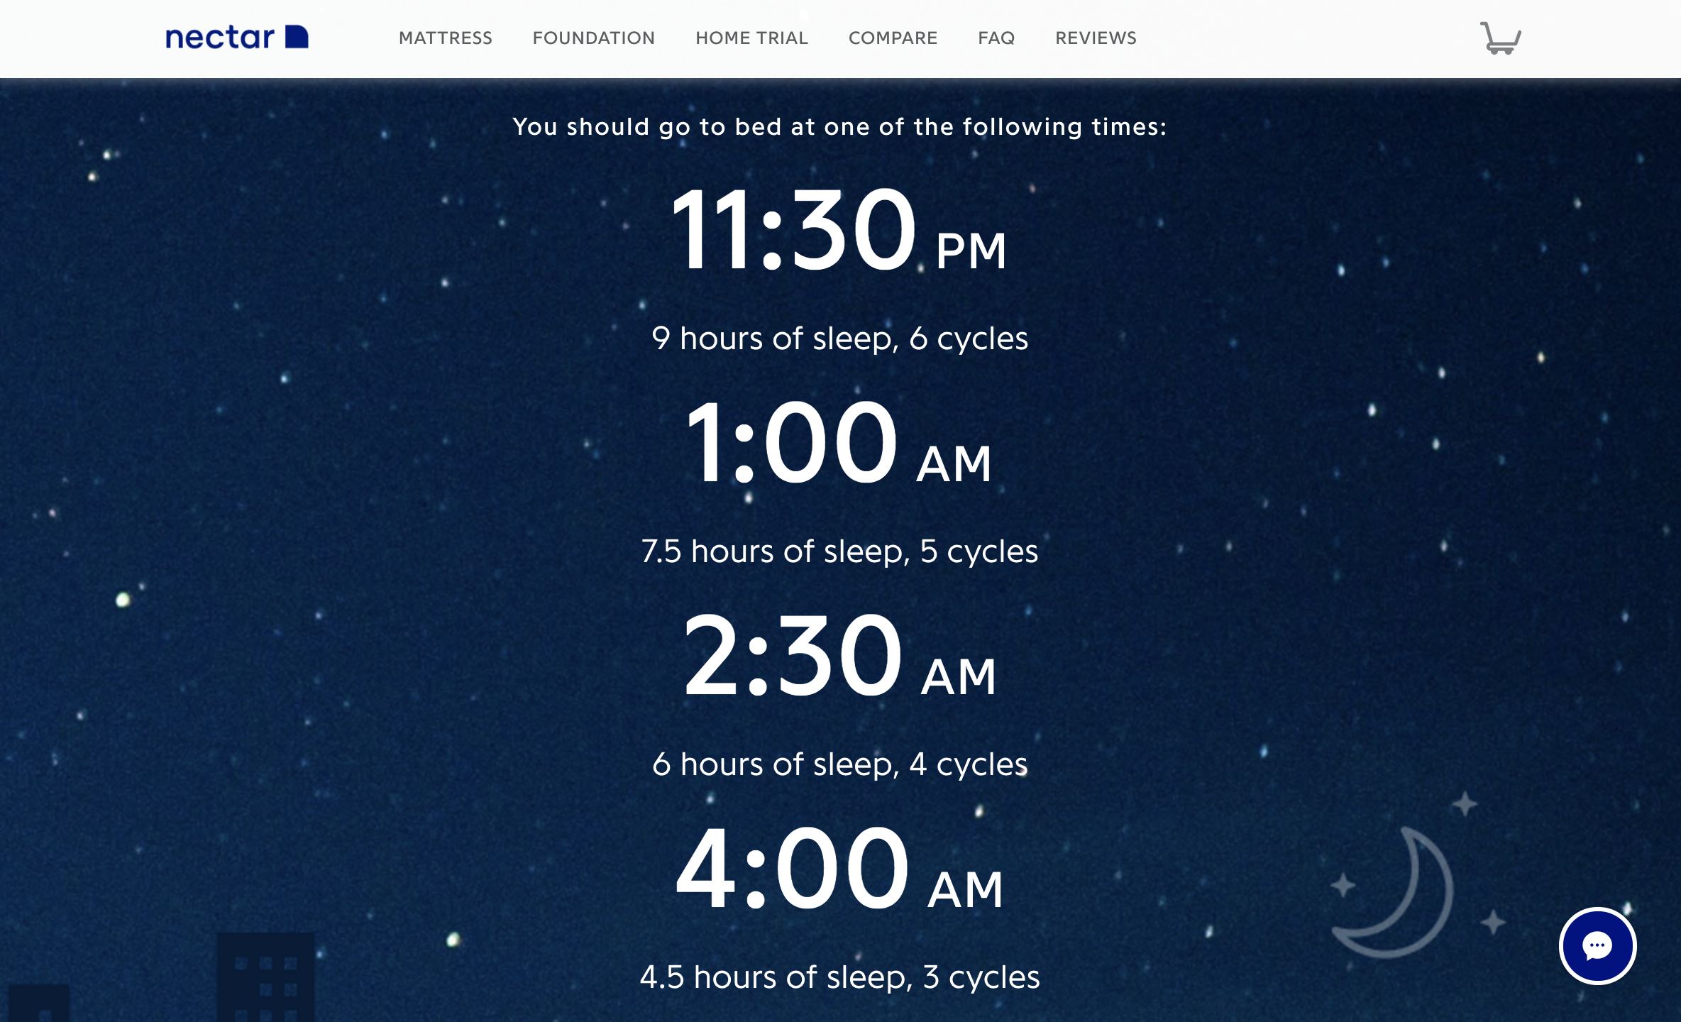
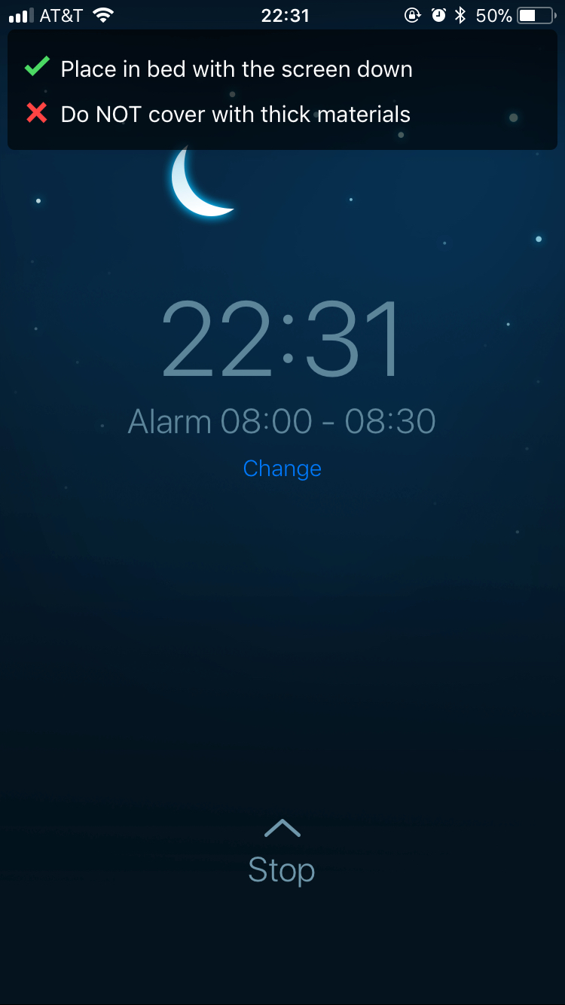
Current Solution - Problems
Website
Used static calculations
Unclear calculation method
Mobile App
Unreliable tracker
Unclear calculation method
Notes:
While they might sometimes be accurate, they won’t always be.

Slide 5

Proposed Solution
Machine learning-based classification model
Use a more reliable features, Electroencephalography (EEG)
Apply model to make a smart alarm system, SmAlarm

Slide 6
SmAlarm
Application accepts user’s preferred time window to wake up
Accepts EEG values real-time each second
Evaluates whether user is in Wake stage
If user is in Wake stage and the time fits the time window,
Ring Alarm!

Slide 7
Data
Sleep Heart Health Study (SHHS) 1 from National Sleep Research Resource (NSRR), with permission
5790 records of EEG data
Sleep duration average = 8.4 hours
14 channels per records
Annotation by NSRR for each record
~350GB total

Slide 8
Hardware
4.0 GHz Intel i7-6700K 8M Skylake Quad-core
16 GB RAM
Nvidia GTX 980
256 GB SSD
1 TB External HDD

Slide 9
Software Dependancies
Ruby 2.3.3
Python 2.7
MNE 0.15.2
PySpark 2.3.0
Scikit-learn 0.18.1
Notes:
Ruby -> download nsrr dataset
Python -> scripting and base language
MNE -> process eeg data
PySpark -> Feature extraction
Sklearn -> training

Slide 10
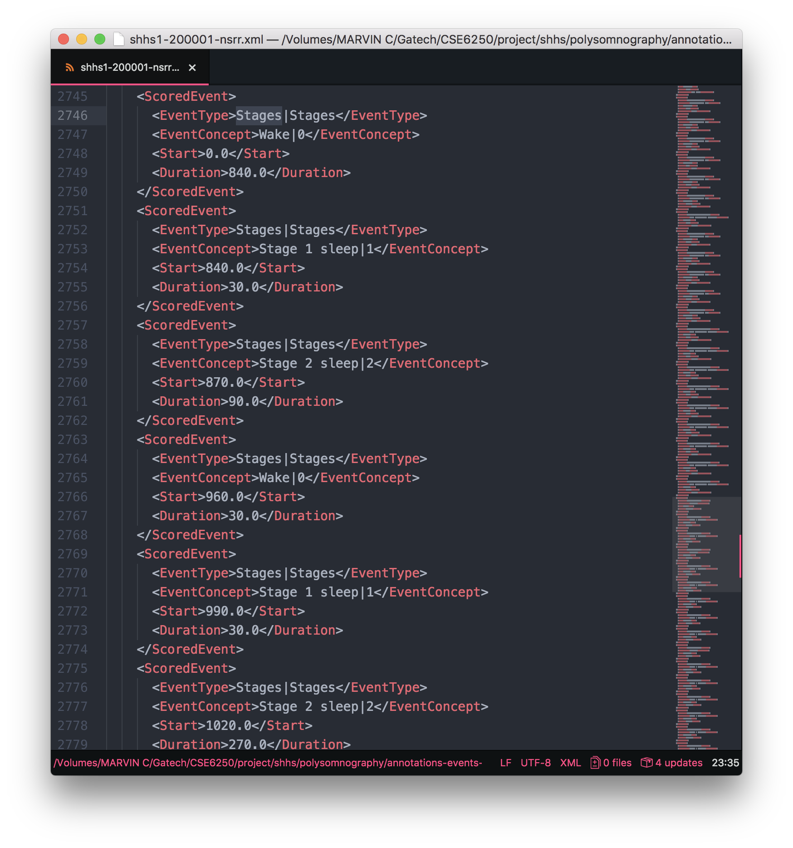
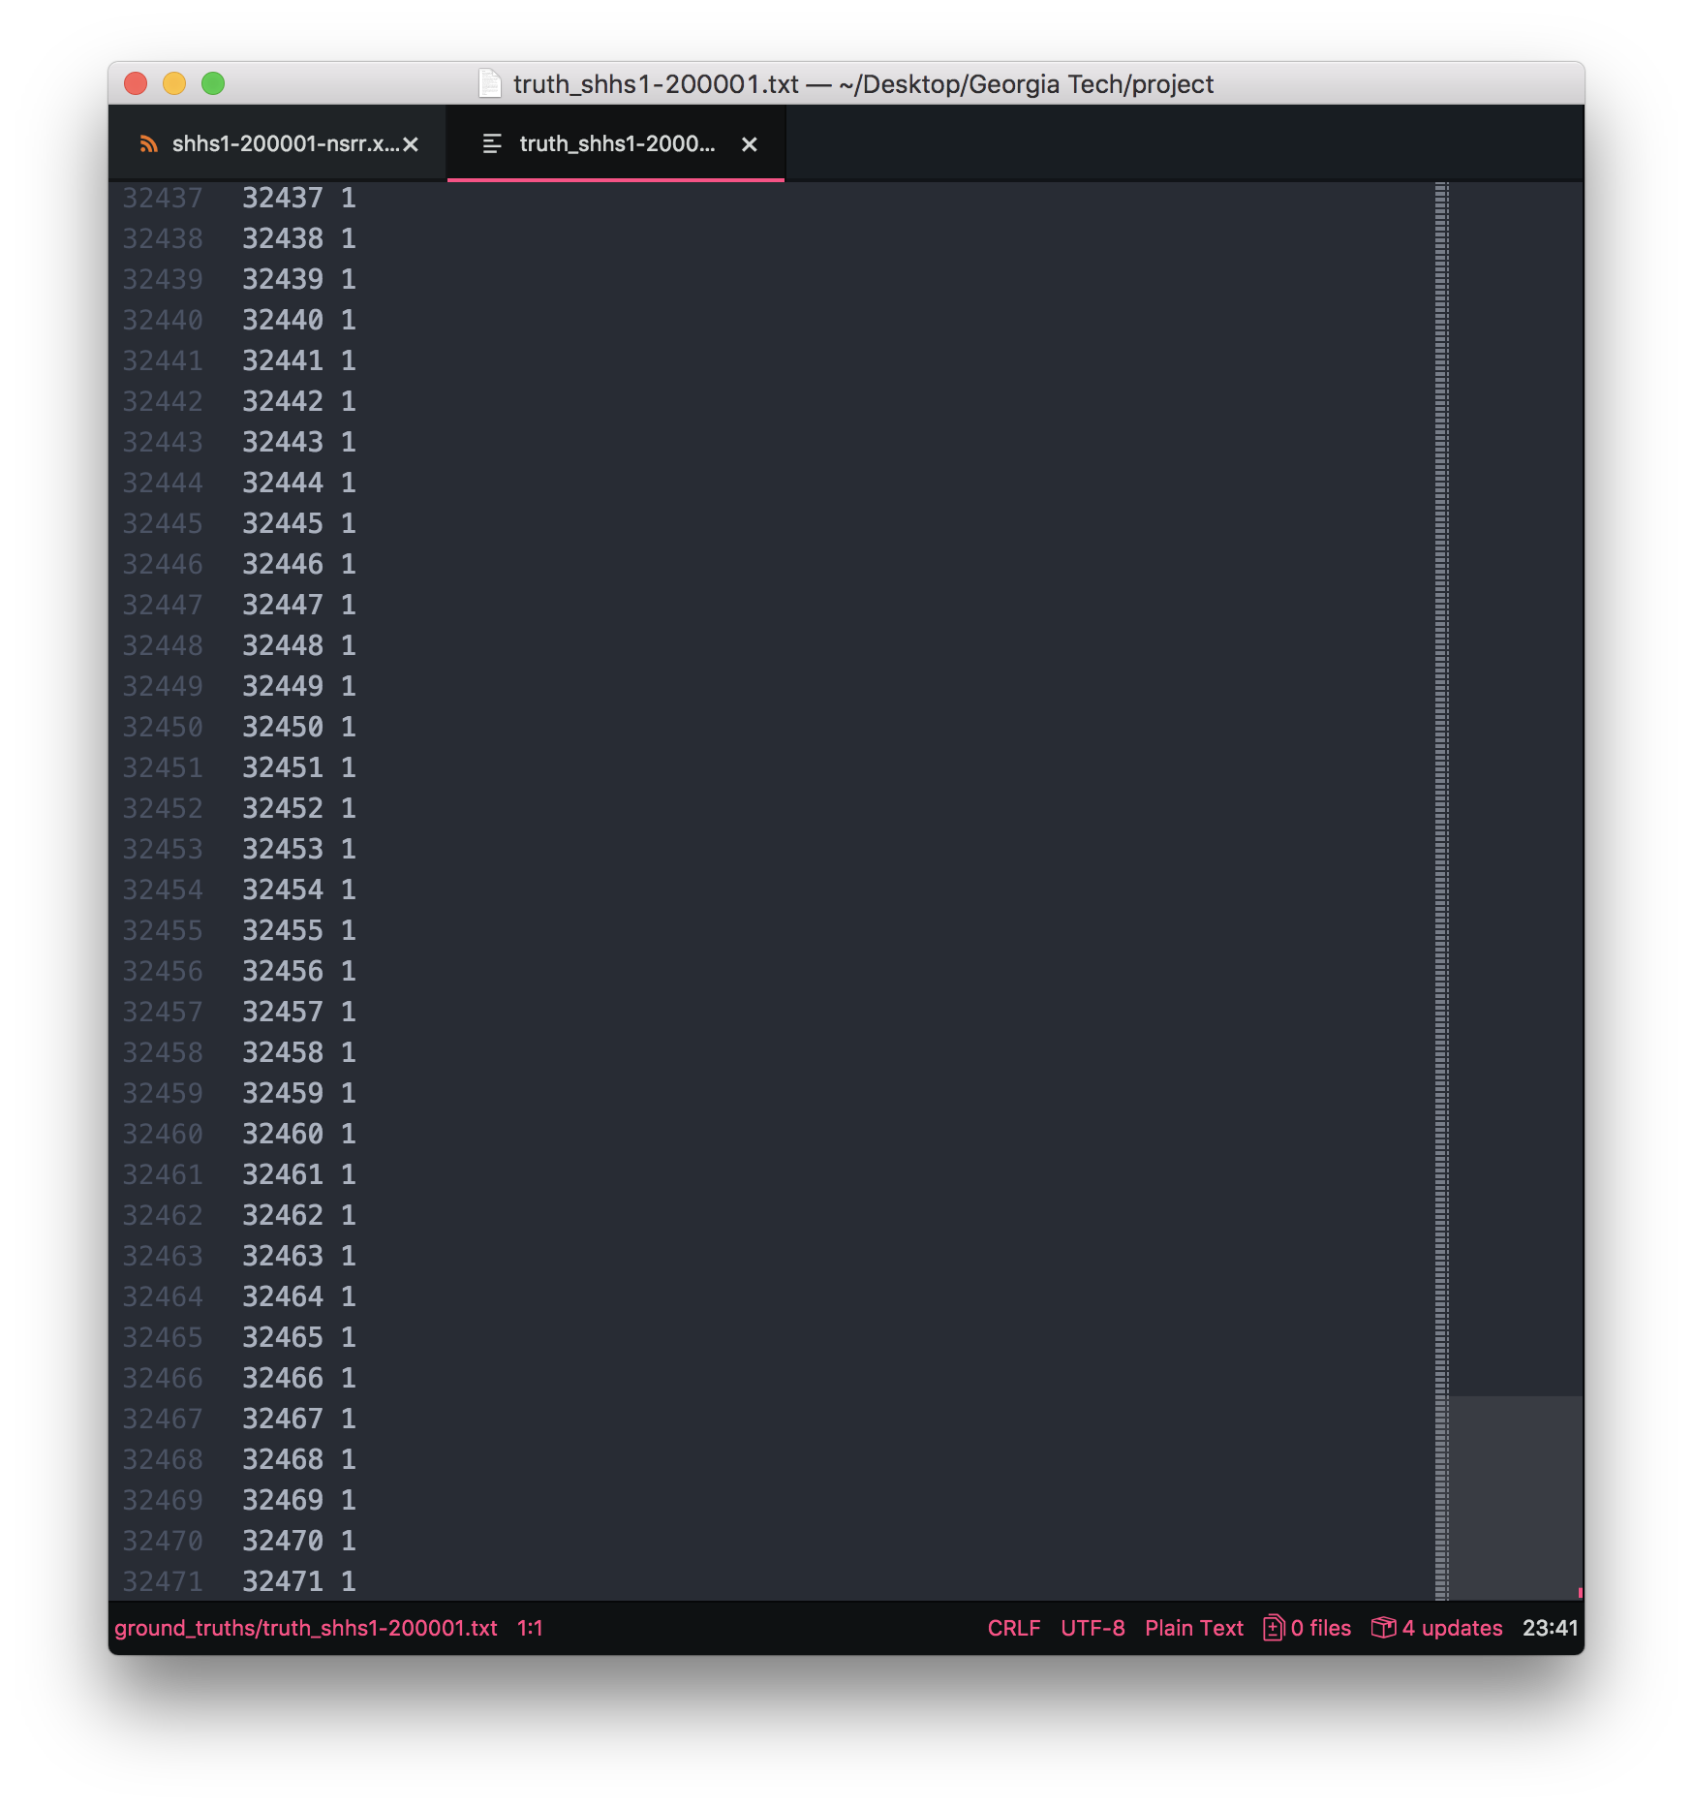


Preprocessing – Ground Truths Extraction
+
NSRR annotation (.xml)
n binary labels Wake stage (1) vs Not Wake stage (0)
n = length of sleep (second)

Slide 11
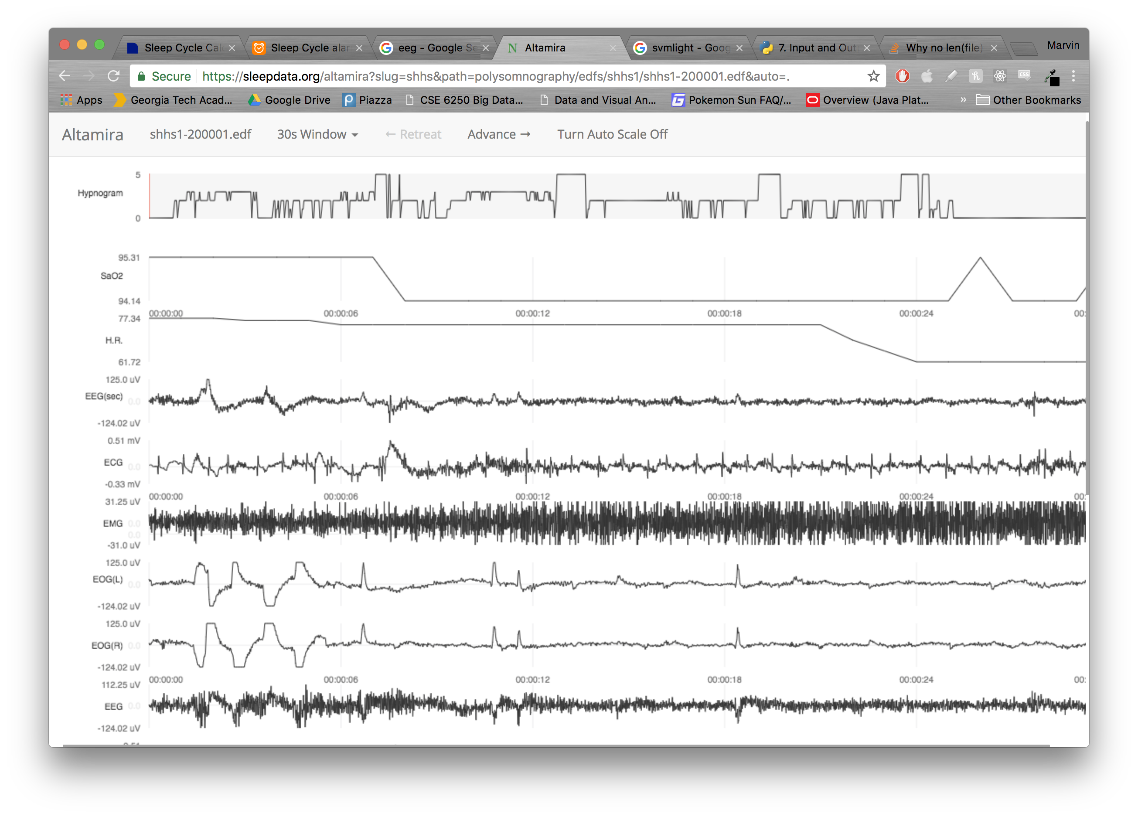
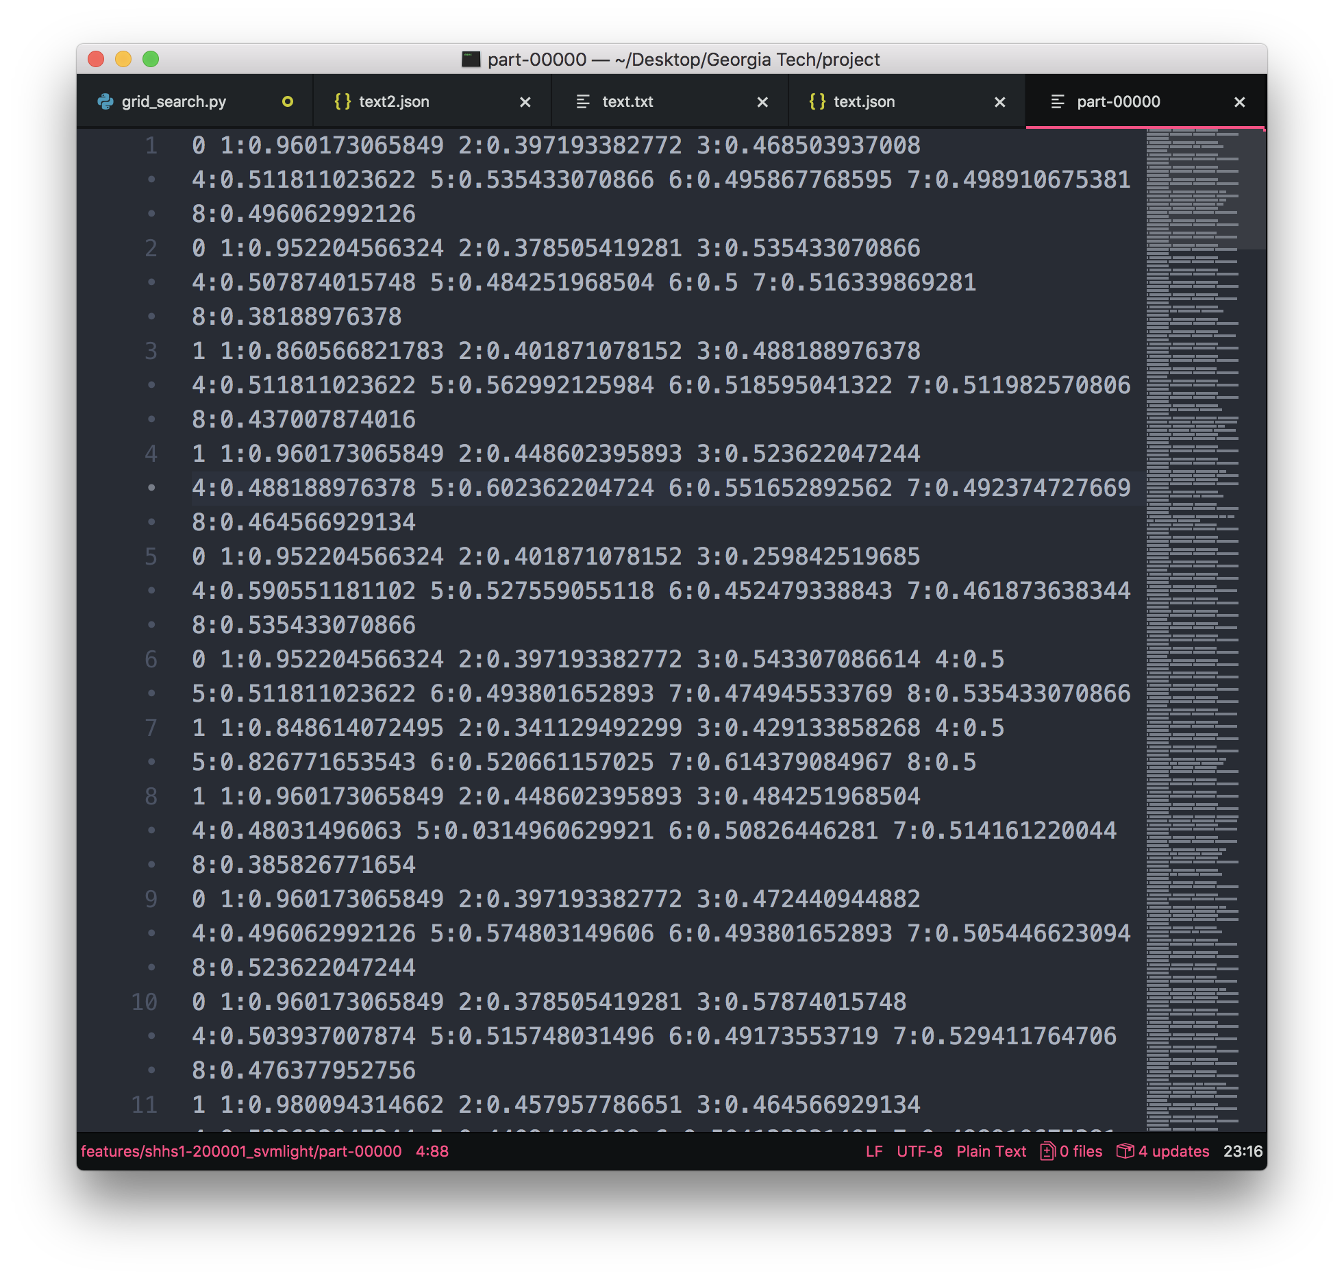

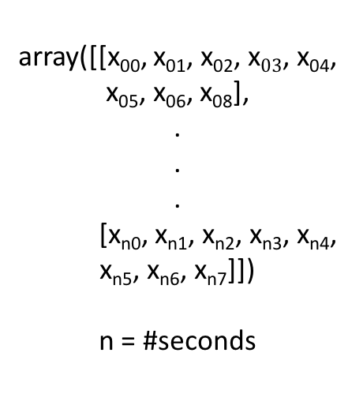
Preprocessing – Feature Extraction
array([[x₀₀, x₀₁, x₀₂, x$03$, x₀₄, x₀₅, x₀₆, x₀₈],
.
.
.
[x_{n0}, x_{n1}, x_{n2}, x_{n3}, x_{n4}, x_{n5}, x_{n6}, x_{n7}]])
n = #seconds
Min-max normalization
Raw eeg file (.edf)
Extracted 8 first channels
n x 8 numpy array
(n varies per person)
n x 8 features
in svmlight format
(n varies per person)
Notes:
For the whole 5790 features, process took 31 hours!!!

Slide 12

Model Training
Training Data
4000 (69%)
Split into folds
40 Folds (2.5%, 100 records/fold)
,
Split
Model fitting
5788
Testing Data
1788 (21%)
,
Logistic Regression classifier model
.
.
.
Evaluate accuracy
every 500 records
Originally 5790, but
ignored 2 inconsistent features
Notes:
Unfortunately my hardware’s memory can’t store bigger fold.

Slide 13
Training Details
Used Grid Search to find the best parameter
Training time = 75.08 minutes
4000 records x 30240 seconds = ~120 million rows

Slide 14
Results
Metrics are averages from testing with 1788 testing data
Accuracy = 77%
Precision = 94%
Recall = 17%
Notes:
Precision is more important because low false positive leads to low chance of mislabeling not wake stage as wake stage. Could appreciate high recall as well.

Slide 15
Implications
SmAlarm can be very useful someday in the future.
Can be improved with more parameter and algorithm tuning
Reach accuracy of SLEEPNET or DeepSleepNet (86%)
Achieve higher recall
Use a much better machine to unlock SmAlarm’s fullest potential
Future Plans

